Slide 1

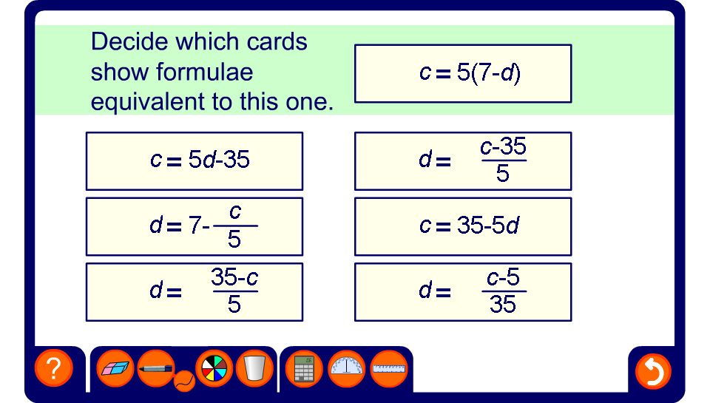


Find the equivalent formulae
Notes:
Ask pupils to decide which of the formulae shown can be rearranged to give the formula shown.

